Slide 1
Computer Vision and Deep Learning
Lecture 6

Slide 2
Today’s agenda
Optimization algorithms
Convolutional neural networks:
History
Case studies
How to read a research paper?

Slide 3
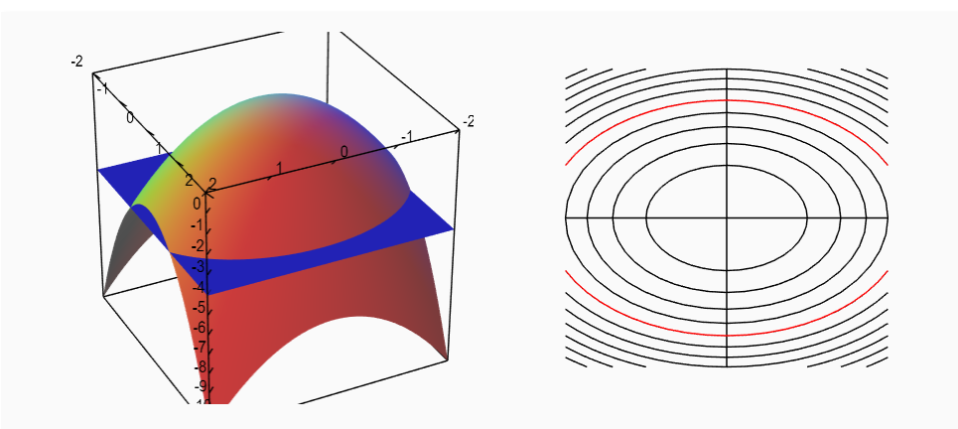
Level sets of a surface
https://mathinsight.org/level_sets

Slide 4
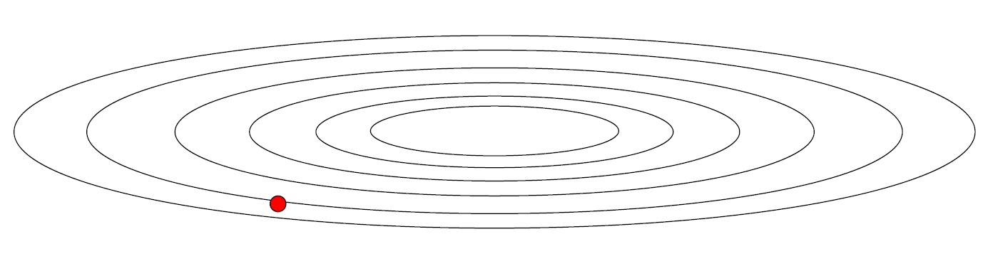
Problems with gradient descent
What if loss changes abruptly on one direction and slower in the other direction?

Slide 5
Problems with gradient descent
What if loss changes abruptly on one direction and slower in the other direction?

Slide 6
Problems with gradient descent
What if loss changes abruptly on one direction and slower in the other direction?
Small gradient horizontally
Large gradient vertically
Slow progress along the horizontal direction, jitter along the vertical direction (the steeper one)

Slide 7
Gradient descent with momentum
Compute an exponentially weighted average of the gradients and use this average to update the parameters of the network

Slide 8
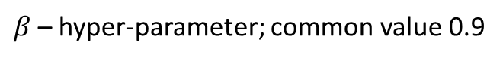
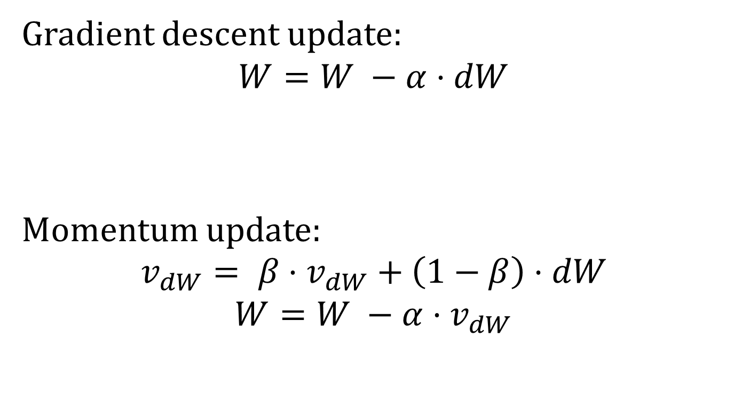
Gradient descent with momentum Update rule
Gradient descent update:
$$W=W −α⋅dW$$
Momentum update:
$$v_{dW}= β⋅v_{dW}+\left(1−β\right)⋅dW$$
$$W=W −α⋅v_{dW}$$
$β$– hyper-parameter; common value 0.9

Slide 9
Gradient descent with momentum
Take more straightforward part (damp oscillations)
Slower learning vertically, faster learning horizontally

Slide 10
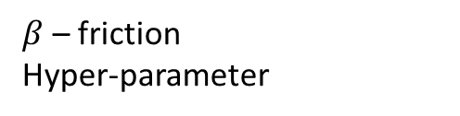

Gradient descent with momentum
Intuition
Ball rolling down the loss function with friction
Gradient: the force the ball is feeling (F = ma)
$$v_{dW}= β⋅v_{dW}+\left(1−β\right)⋅dW$$
$β$ – friction
Hyper-parameter
velocity
acceleration
Shallow, consistent direction: build up the velocity across the dimension
Steep direction: attenuate velocity (quickly changing sign); oscillate to the “middle”

Slide 11

Gradient descent with momentum Update rule - variant
$$v_{dW}= β⋅v_{dW}+\left(1−β\right)dW$$
$$v_{dW}= β⋅v_{dW}+dW$$
$$W=W −α⋅v_{dW}$$
$β$– hyper-parameter; common value 0.9

Slide 12
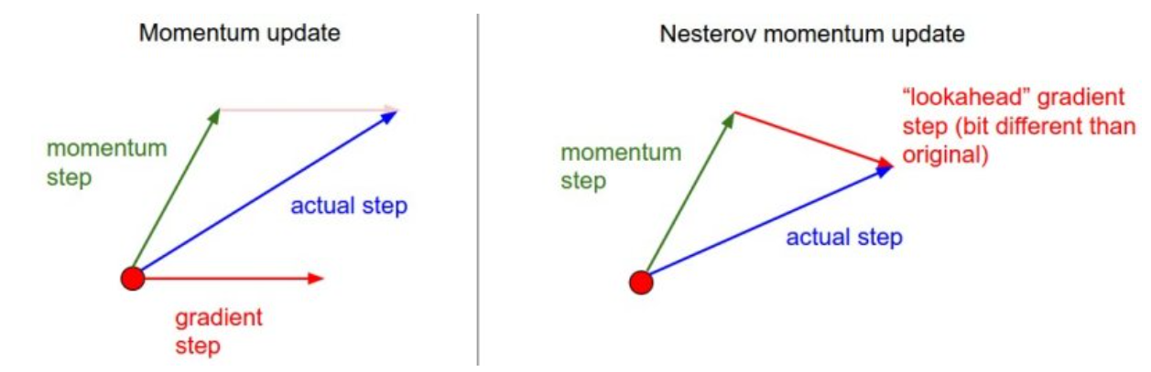
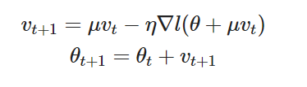
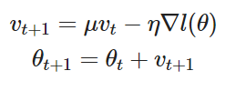
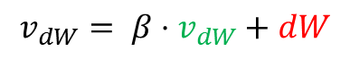
Nesterov momentum
$$v_{dW}= β⋅v_{dW}+dW$$
Image source: https://cs231n.github.io/neural-networks-3/#sgd
https://dominikschmidt.xyz/nesterov-momentum/

Slide 13
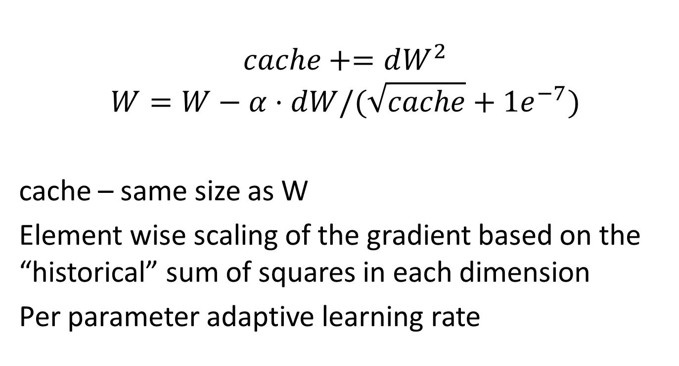
AdaGrad
$$cache+=dW^{2}$$
$$W=W−α⋅dW/(\sqrt{cache}+1e^{−7})$$
cache – same size as W
Element wise scaling of the gradient based on the “historical” sum of squares in each dimension
Per parameter adaptive learning rate

Slide 14
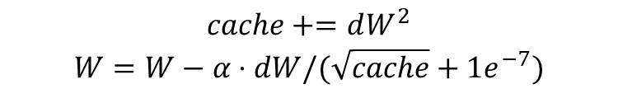
AdaGrad
$$cache+=dW^{2}$$
$$W=W−α⋅dW/(\sqrt{cache}+1e^{−7})$$
Equalizing effect
Larger learning rate on “shallow” directions than on steeper directions

Slide 15

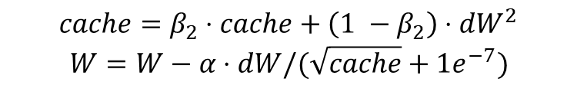
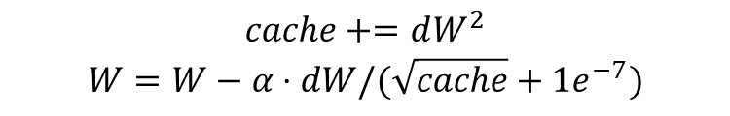
RMSProp
$$cache+=dW^{2}$$
$$W=W−α⋅dW/(\sqrt{cache}+1e^{−7})$$
Adagrad
$$cache=β_{2}⋅cache+\left(1 −β_{2}\right)⋅dW^{2}$$
$$W=W−α⋅dW/(\sqrt{cache}+1e^{−7})$$
RMSProp
Introduced by Geoffrey Hinton on a lecture on Coursera:

Slide 16


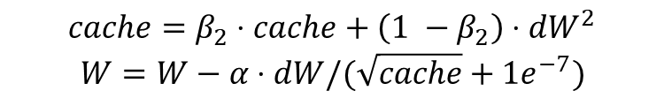
Adam
Combine RMSProp with momentum
$$m=β_{1}⋅m+\left(1 −β_{1}\right)⋅dW$$
$$v=β_{2}⋅v+\left(1 −β_{2}\right)⋅dW^{2}$$
$$W=W−α⋅m/(\sqrt{v}+1e^{−7})$$
momentum
(velocity)
RMSProp like
RMSProp
$$cache=β_{2}⋅cache+\left(1 −β_{2}\right)⋅dW^{2}$$
$$W=W−α⋅dW/(\sqrt{cache}+1e^{−7})$$

Slide 17
Adam
Combine RMSProp with momentum
$$m=β_{1}⋅m+\left(1 −β_{1}\right)⋅dW$$
$$v=β_{2}⋅v+\left(1 −β_{2}\right)⋅dW^{2}$$
$$W=W−α⋅m/(\sqrt{v}+1e^{−7})$$
momentum
(velocity)
RMSProp like
RMSProp
$$cache=β_{2}⋅cache+\left(1 −β_{2}\right)⋅dW^{2}$$
$$W=W−α⋅dW/(\sqrt{cache}+1e^{−7})$$
Noisy gradients

Slide 18

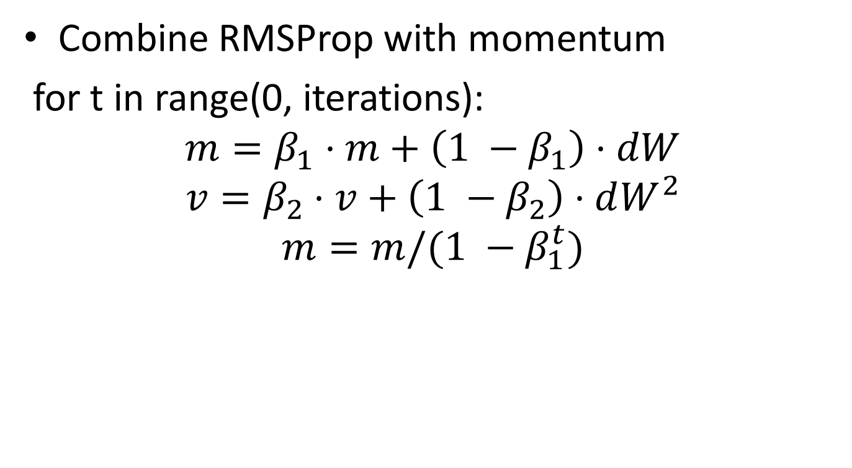

Adam
Combine RMSProp with momentum
for t in range(0, iterations):
$$m=β_{1}⋅m+\left(1 −β_{1}\right)⋅dW$$
$$v=β_{2}⋅v+\left(1 −β_{2}\right)⋅dW^{2}$$
$$m=m/(1 −β_{1}^{t})$$
$$v=v/(1 −β_{2}^{t})$$
Bias correction
$$W=−α⋅m/(\sqrt{v}+1e^{−7})$$

Slide 19
http://www.denizyuret.com/2015/03/alec-radfords-animations-for.html

Slide 20
Optimization algorithms
https://awesomeopensource.com/project/3springs/viz_torch_optim

Slide 21
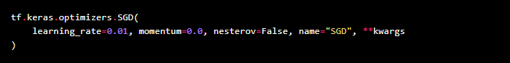
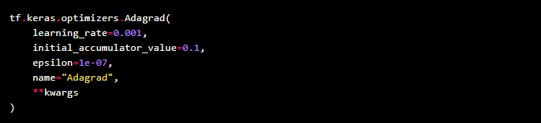
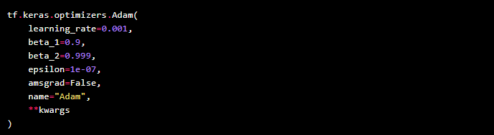
Optimizers in keras

Slide 22
Optional additional reading
https://ruder.io/optimizing-gradient-descent/index.html#otherrecentoptimizers
https://www.youtube.com/watch?v=k8fTYJPd3_I
https://www.youtube.com/watch?v=_e-LFe_igno
https://www.coursera.org/lecture/deep-neural-network/the-problem-of-local-optima-RFANA

Slide 23
Training a neural network
Learning rate scheduling

Slide 24
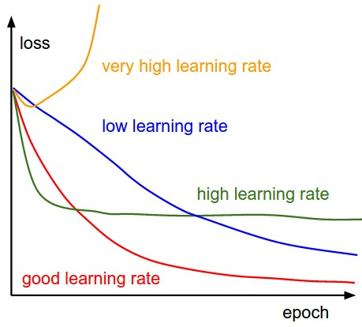
Learning rate

Slide 25
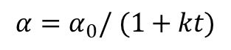

Learning rate decay
Learning rate decay over time!
Use a larger learning rate at the beginning and progressively reduce the learning rate
t epoch, k – decay rate
Step decay:
reduce learning rate by half after some epochs
Exponential decay
1/t decay
$$α=α_{0}⋅e^{−kt}$$
$$α=α_{0}/ (1+kt)$$

Slide 26
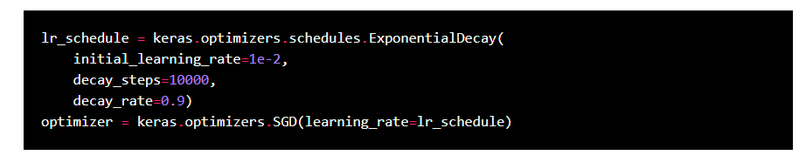
keras optimizers schedules

Slide 27
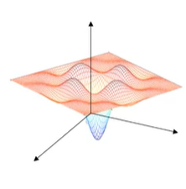
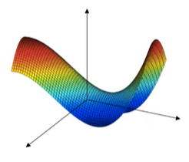
Problem of local optima
Gradient is zero -> in each direction it can either be a convex like a concave like function.
Saddle points.
Unlikely to get stuck in local optima
https://www.coursera.org/lecture/deep-neural-network/the-problem-of-local-optima-RFANA

Slide 28
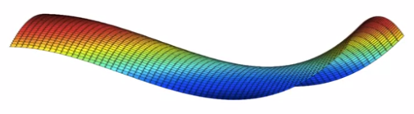
Problem of plateaus
Plateaus can make the learning process too slow

Slide 29

Previously Convolutional neural networks
Convolutional neural networks
Convolutional layers
Pooling layers
Fully connected layers

Slide 30
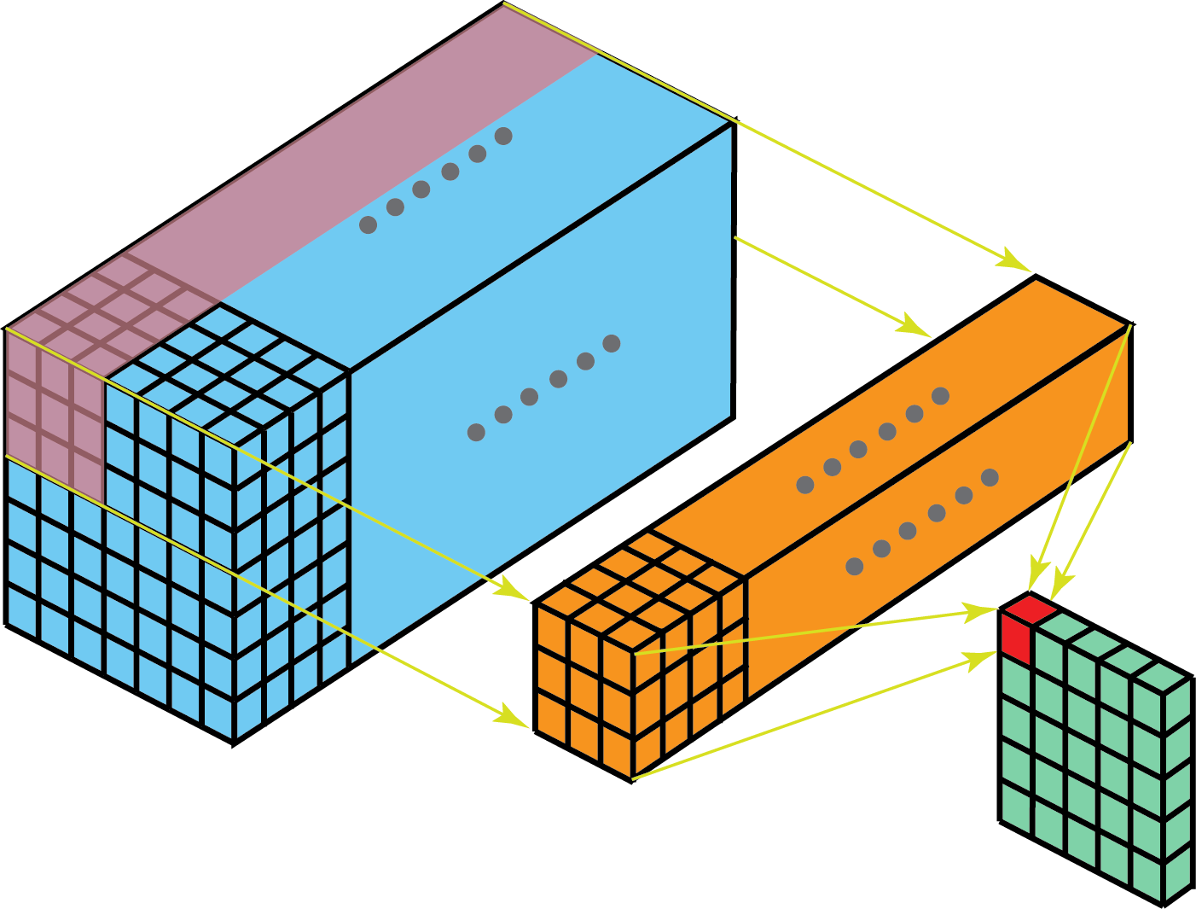
Convolution layers
Shared parameters
Sparsity of connections
Image source: https://towardsdatascience.com/a-comprehensive-introduction-to-different-types-of-convolutions-in-deep-learning-669281e58215

Slide 31
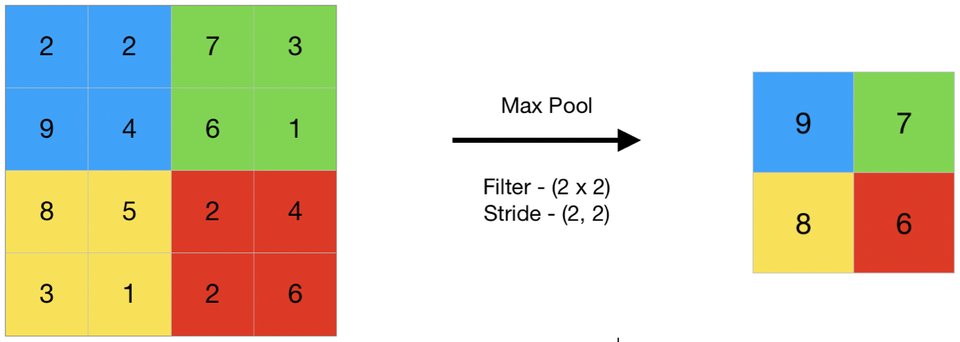
Pooling layers

Slide 32
Previously Convolutional neural networks
Training a neural network
Good initialization
Batch normalization
Regularization
Batch training
Stochastic gradient descent
Mini-batch gradient descent
Batched gradient descent
Optimizers

Slide 33
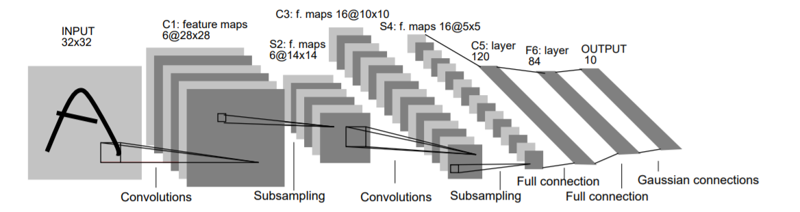
LeNet 5
Conv filters have size 5x5 and are applied at stride 1
Subsampling (Pooling) layers have size 2x2 and are applied at stride 2
[CONV-POOL-CONV-POOL-FC-FC]

Slide 34
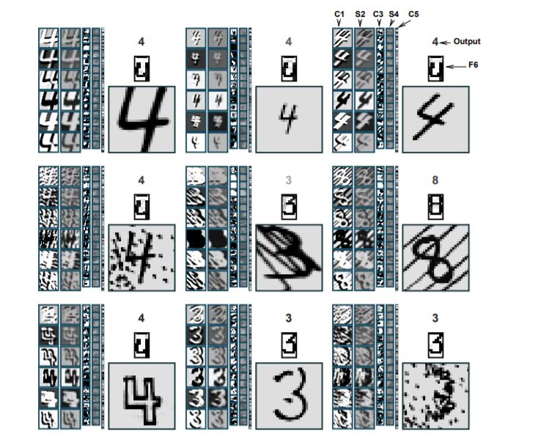
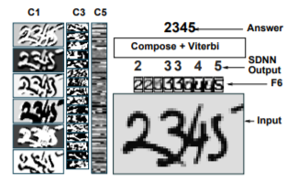
LeNet 5

Slide 35


2012
14,197,122 images
1000 categories

Slide 36
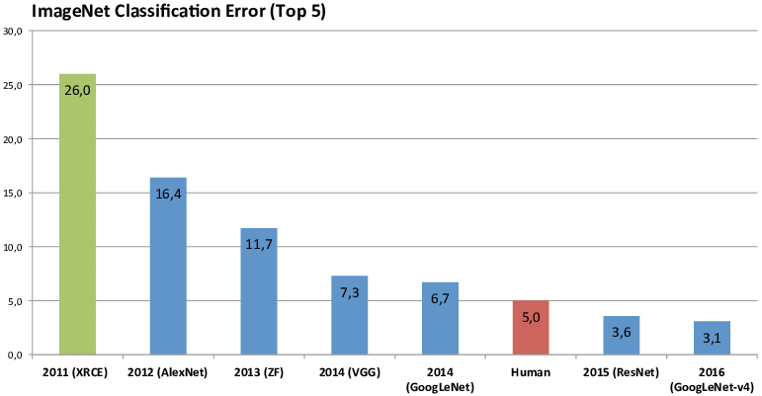

Slide 37
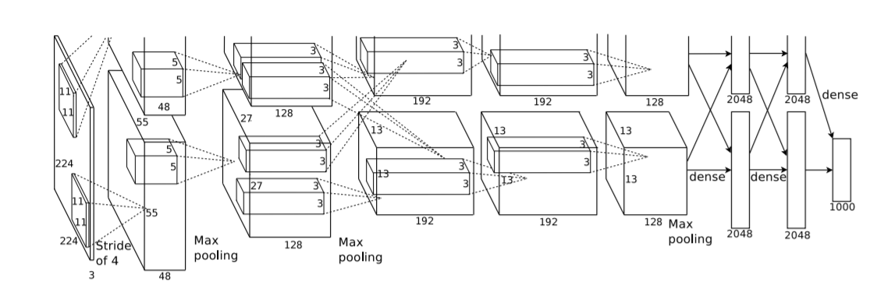
Alexnet, 2012
A single GTX 580 GPU has only 3GB of memory, which limits the maximum size of the networks
that can be trained on it.

Slide 38
Alexnet, 2012
$$W_{o}=\frac{W_{I} −F+2P}{S}+1$$
Image size: (227, 227, 3)
First layer: 96 filter of size 11x11
What is the output volume size and the number of parameter in this layer?

Slide 39
Alexnet, 2012
$$W_{o}=\frac{W_{I} −F+2P}{S}+1$$
Image size: (227, 227, 3)
First layer: 96 filter of size 11x11
Output volume: 55x55x96
Parameters: (11*11*3)*96 ~ 35K

Slide 40
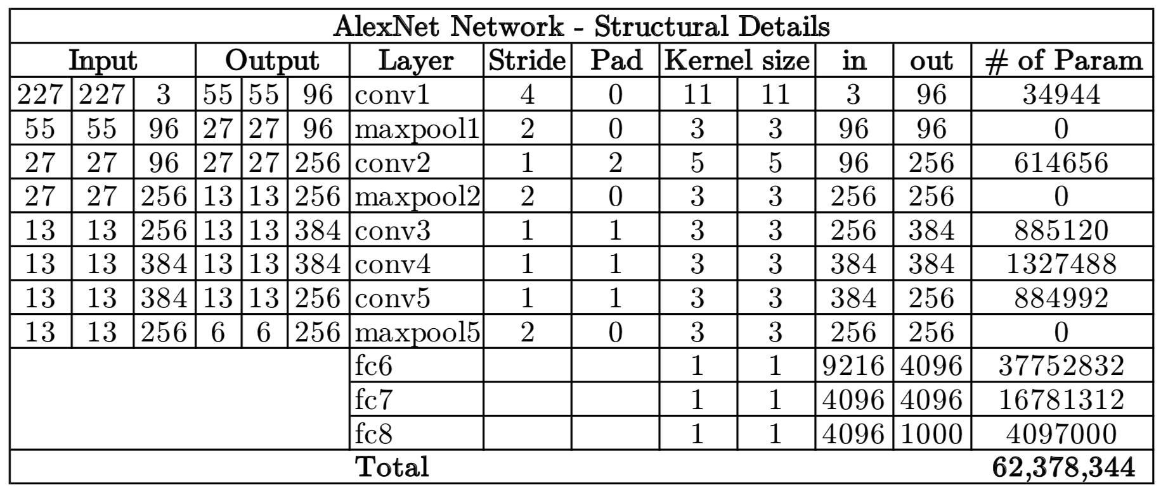
Alexnet

Slide 41
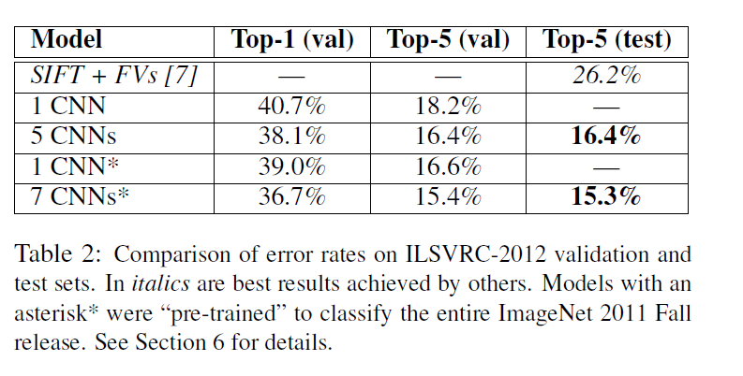
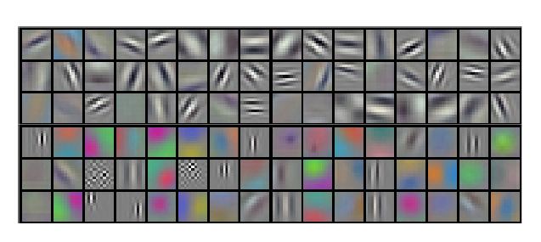
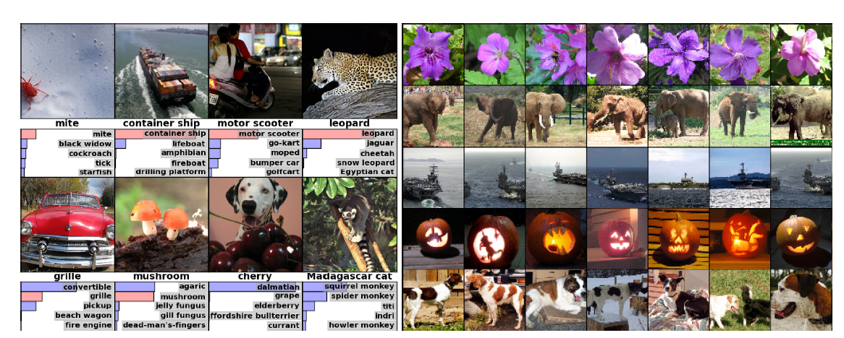
Alexnet

Slide 42
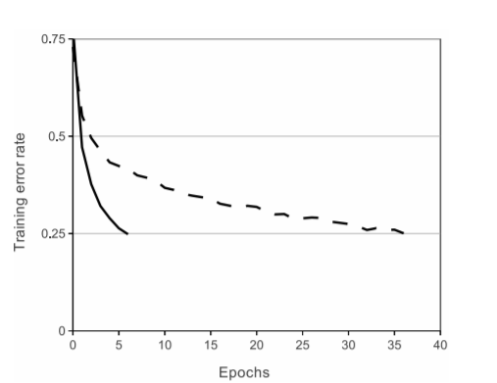
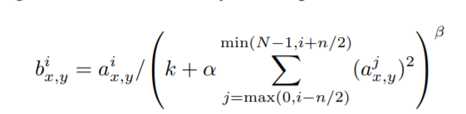
Alexnet – key features
First use of ReLU
Overlapped max pooling
Used normalization layers
Not used anymore
RELU (solid line) effect on training
vs tanh (dashed line)

Slide 43
Alexnet – key features
Training setup
Dropout 0.5
Data augmentation
Batch size 128
Gradient descent with momentum (beta = 0.9)
Initial learning rate: 1e-2, reduced manually, when a plateau was reached
7 Alexnet ensemble: 18.2% -> 15.4%

Slide 44
ZFNet, 2013
Built on top of Alexnet, improved hyperparameters

Slide 45
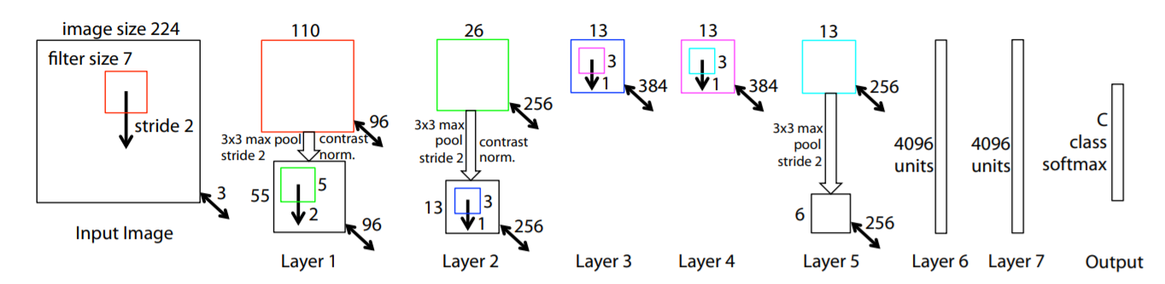
ZFNet
CONV1: change from (11x11 stride 4) to (7x7 stride 2)
CONV3, 4, 5: instead of 384, 384, 256 filters use 512, 1024, 512

Slide 46
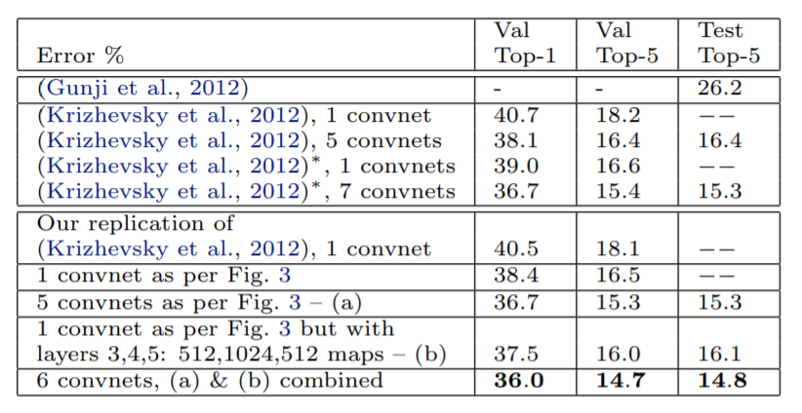

ZFNet
CONV1: change from (11x11 stride 4) to (7x7 stride 2)
CONV3, 4, 5: instead of 384, 384, 256 filters use 512, 1024, 512
ImageNet top 5 error: 15.4% -> 14.8%

Slide 47
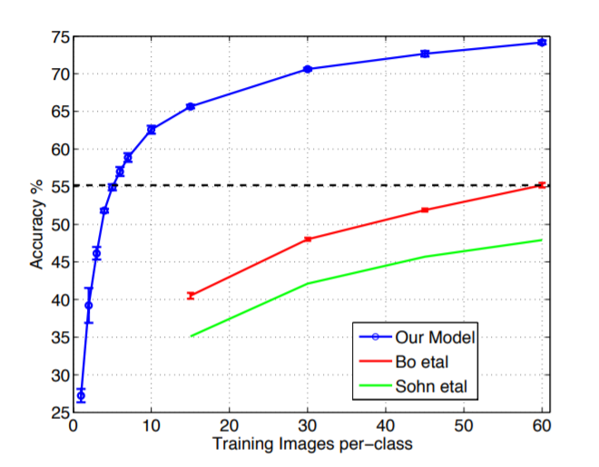

ZFNet – feature generalization
Caltech 256

Slide 48
VGG, 2014

Slide 49
VGG
Simplifies the network architectures
Always use 3x3 filters for convolutions
Always use max pooling of filter size 2x2 and a stride of 2

Slide 50
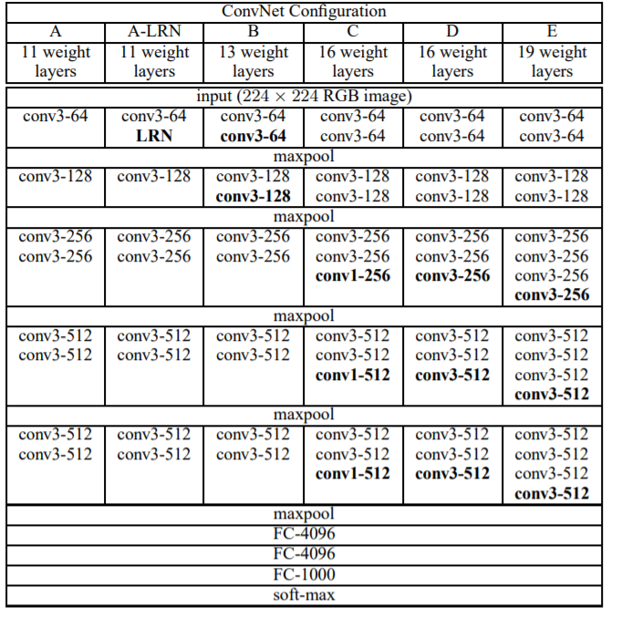
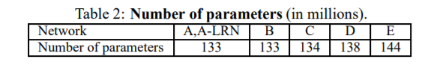
VGG
- Always use 3x3 filters for convolutions
Always use max pooling of filter size 2x2 and a stride of 2
Top 5 accuracy: 11.7 -> 7.3

Slide 51
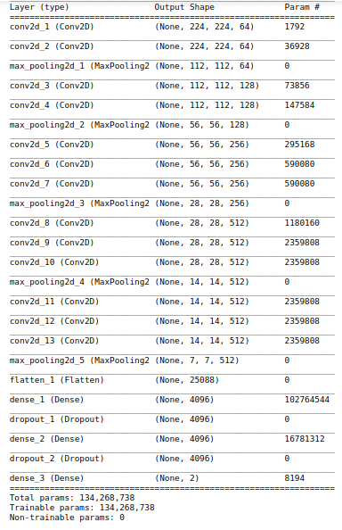
VGG

Slide 52
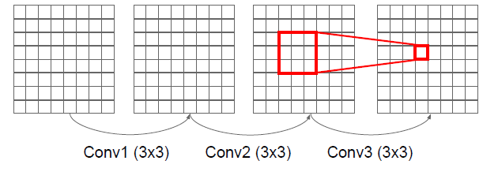
VGG
“It is easy to see that a stack of two 3×3 conv. layers has an effective receptive field of 5×5; three such layers have a 7 × 7 effective receptive field.”

Slide 53

VGG
“It is easy to see that a stack of two 3×3 conv. layers has an effective receptive field of 5×5; three such layers have a 7 × 7 effective receptive field.”

Slide 54

VGG
“It is easy to see that a stack of two 3×3 conv. layers has an effective receptive field of 5×5; three such layers have a 7 × 7 effective receptive field.”

Slide 55

VGG
“It is easy to see that a stack of two 3×3 conv. layers has an effective receptive field of 5×5; three such layers have a 7 × 7 effective receptive field.”

Slide 56

VGG
“It is easy to see that a stack of two 3×3 conv. layers has an effective receptive field of 5×5; three such layers have a 7 × 7 effective receptive field.”

Slide 57
VGG
“It is easy to see that a stack of two 3×3 conv. layers has an effective receptive field of 5×5; three such layers have a 7 × 7 effective receptive field.”
What is the effect of this replacement in terms on the number of parameters?
What about non-linearities?

Slide 58
VGG
“It is easy to see that a stack of two 3×3 conv. layers has an effective receptive field of 5×5; three such layers have a 7 × 7 effective receptive field.”
What is the effect of this replacement in terms on the number of parameters?
3*(3²C) = 27C vs 7²C = 49C
What about non-linearities?

Slide 59
VGG – key features
Did not use local response normalization layers
Use ensembles to boost performance
Use VGG 16 or VGG 19 (VGG 19 brings only a small increase in performance, but it requires more memory)
Similar training procedure as in AlexNet

Slide 60


Slide 61
GoogLeNet, 2014
8 layers
8 layers
16/19 layers
22 layers
6.7 top-5 accuracy

Slide 62



GoogLeNet
This name is an homage to Yann LeCun’s pioneering LeNet 5 network
Inception module

Slide 63
Inception module
You don’t need to ”pick” the filter sizes, instead you let the network “choose” between several values
Filters of different sizes
Pooling layer
Concatenate activations depth-wise

Slide 64

Inception module

Slide 65
Inception module
What are the output sizes of all these operations?
128
192
96
?
Input: 28x28x256

Slide 66
Inception module
28x28x128
28x28x192
28x28x96
28x28x256
128
192
96
Input: 28x28x256

Slide 67
Inception module
28x28x(128+192+96+256) = 28x28x672
28x28x128
28x28x192
28x28x96
28x28x256
128
192
96
Input: 28x28x256

Slide 68
Inception module
28x28x(128+192+96+256) = 28x28x672
28x28x128
28x28x192
28x28x96
28x28x256
128
192
96
Input: 28x28x256
[1x1 conv, 128 filters]: ? convolution operations
[3x3 conv, 192 filters]: ? convolution operations
[5x5 conv, 96 filters]: ? convolution operations

Slide 69
Inception module
28x28x(128+192+96+256) = 28x28x672 = 526848
28x28x128
28x28x192
28x28x96
28x28x256
128
192
96
Input: 28x28x256
[1x1 conv, 128 filters]: 28x28x128x1x1x256
[3x3 conv, 192 filters]: 28x28x192x3x3x256
[5x5 conv, 96 filters]: 28x28x96x5x5x256
>850M

Slide 70

Bottleneck
Use bottleneck layers to reduce the depth dimensions of the activations
use 1x1 convolutions

Slide 71

1x1 convolutions
Each filter has a 1x1xD size and performs a D-dimensional dot product

Slide 72
1x1 convolutions
image source : https://medium.com/hitchhikers-guide-to-deep-learning/6-introduction-to-deep-learning-with-computer-vision-3x3-is-a-lie-1x1-convolutions-9edd2baf7fd5

Slide 73

1x1 convolution

Slide 74
The real Inception module

Slide 75
The real Inception module
192
96
64
128
64
64
Input: 28x28x256
[1x1 conv, 64] ??
[1x1 conv, 64] ??
[1x1 conv, 128] ??
[3x3 conv, 192] ??
[5x5 conv, 96] ??
[1x1 conv, 64] ??

Slide 76
The real Inception module
192
96
64
128
64
64
Input: 28x28x256
[1x1 conv, 64] 28x28x64x1x1x256
[1x1 conv, 64] 28x28x64x1x1x256
[1x1 conv, 128] 28x28x128x1x1x256
[3x3 conv, 192] 28x28x192x3x3x64
[5x5 conv, 96] 28x28x96x5x5x64
[1x1 conv, 64] 28x28x64x1x1x256
>850M
358M

Slide 77
GoogLe Net
Stack Inception modules on top of each other

Slide 78
GoogLe Net
Inception modules
Classifier output removes FC layers
Stem network:
Conv – Pool – 2x Conv-Pool

Slide 79
GoogLe Net
Output layers to inject additional gradient at lower layers
AvgPool – 1x1 Conv – FC – FC - Softmax

Slide 80
GoogLe Net
Stack Inception modules on top of each other

Slide 81
GoogLe Net
Removes fully connected layers
It was found that a move from fully connected layers to average pooling improved the top-1 accuracy by about 0.6%.

Slide 82
Global average pooling Network In Network, 2014
Instead of adding fully connected layers on top of the feature maps, take the average of each feature map, and the resulting vector is fed directly into the softmax layer.
is more native to the convolution structure by enforcing correspondences between feature maps and categories (feature maps can be easily interpreted as categories confidence maps)
no parameter to optimize in the global average pooling thus overfitting is avoided at this layer
sums up spatial information -> more robust to spatial translations of the input

Slide 83

Global average pooling (GAP)

Slide 84

GoogLe Net
22 layers
Inception module
12x less parameters than AlexNet
Top 5 accuracy: 6.7%
Removes fully connected layers as in NIN
implementation differs in that we use an extra linear layer

Slide 85
ResNet, 2015
8 layers
8 layers
22 layers
22 layers
152 layers
6.7 top-5 accuracy

Slide 86

Res Net Increasing a network depth
Overfitting?
Image source: https://towardsdatascience.com/an-overview-of-resnet-and-its-variants-5281e2f56035

Slide 87
Res Nets Increasing a network depth
Overfitting? NO!
Hypothesis: Deeper models are harder to optimize
Image source: https://towardsdatascience.com/an-overview-of-resnet-and-its-variants-5281e2f56035

Slide 88
Res Nets
Deeper models shouldn’t hurt performance, they should be at least as good as shallower ones
Copy the learned layers from the shallower layer and set additional layers to identity mapping

Slide 89







Classical neural network block
Image source: http://datahacker.rs/deep-learning-residual-networks/
Example credit: Andrew Ng

Slide 90



Residual block
Image source: http://datahacker.rs/deep-learning-residual-networks/

Slide 91


Residual block
Image source: http://datahacker.rs/deep-learning-residual-networks/

Slide 92

Res Net
Try to fit a residual mapping instead of directly trying to fit a desired underlying mapping

Slide 93
Residual blocks
Residual blocks
Main path
Shortcut

Slide 94

Res Net
Start with a CONV layer
Stack multiple residual blocks on top of each other
Every residual block has two 3x3 conv layers
Periodically, double number of filters and downsample spatially using stride 2
No fully connected layers

Slide 95

Res Net > 50 layers
Use “bottlenecks” just like in Inception networks
A deeper residual function F for ImageNet. Left: a building block (on 56×56 feature maps) as in Fig. 3 for ResNet34. Right: a “bottleneck” building block for ResNet-50/101/152.

Slide 96
Res Net
Allows us to train really deep networks
“Identity Mappings in Deep Residual Networks”, 2016 – trained a 1001-layer deep ResNet to outperform its shallower counterparts
Helps us with vanishing and exploding gradients
It is easy for ResNet to learn the identity function

Slide 97

Res Net
1st places on:
ImageNet detection
ImageNet localization
COCO detection
COCO segmentation

Slide 98
Res Net
- Batch Normalization after every CONV layer
- He initialization
- Momentum gradient descent (0.9)
Learning rate: 0.1, divided by 10 when validation error plateaus
- Mini-batch size 256
- Weight decay of 1e-5
- No dropout used

Slide 99

Conv nets – the big picture
An Analysis of Deep Neural Network Models for Practical Applications

Slide 100


Conv nets – the big picture

Slide 101
How to read a research paper?
Read the Title, the abstract and the figures
get a general sense of the concepts in the paper
Read the introduction + conclusions + figures + skim the rest
author(s) try to summarize their work carefully to clarify for the reviewer why their paper should be accepted for publication
Read the paper but skip the math
Read the whole thing but skip the parts that don’t make sense
some of it doesn’t make sense (it’s not unusual), it’s okay to skim it initially.

